Slide 1
Water quality index

Slide 2
What is Water Quality index?
To get a comprehensive picture of overall quality of groundwater, the WQI is used.
WQI is defined as a rating reflecting the composite influence of different water quality parameters on the overall quality of water.
The Indian standard specified for drinking water (BIS, 1991) is used for the calculation of WQI.

Slide 3
Water Quality Index (WQI) is considered as the most effective method of measuring water quality. A number of water quality parameters are included in a mathematical equation to rate water quality, determining the suitability of water for drinking
The index was first developed by Horton in 1965 to measure water quality by using 10 most regularly used water parameters.
The method was subsequently modified by different experts. These indices used water quality parameters which vary by number and types.
The weights in each parameter are based on its respective standards, and the assigned weight indicates the parameter’s significance and impacts on the index.

Slide 4

Calculation
A usual WQI method follows three steps which include
(1) selection of parameters,
(2) determination of quality function for each parameter, and
(3) aggregation through mathematical equation
The index provides a single number that represents overall water quality at a certain location and time based on some water parameters.
The index enables comparison between different sampling sites.
The single-value output of this index, derived from several parameters, provides important information about water quality that is easily interpretable, even by lay people

Slide 5
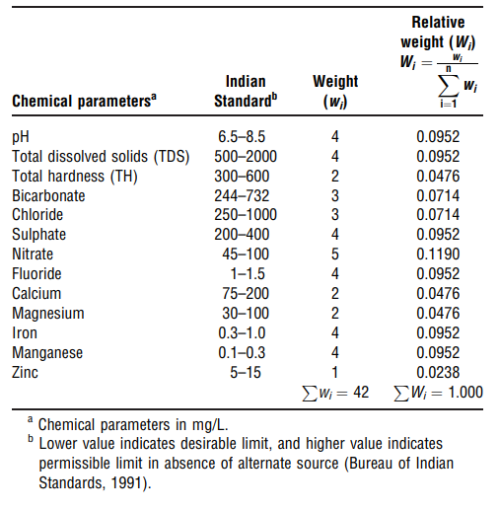

Slide 6
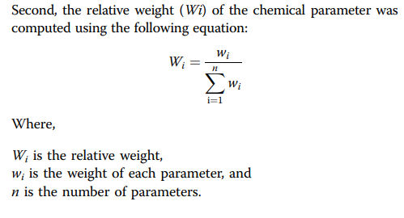

Slide 7
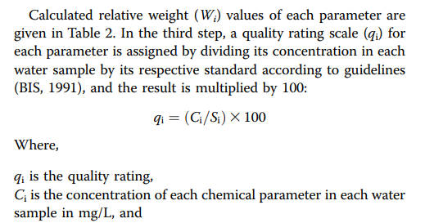


Slide 8
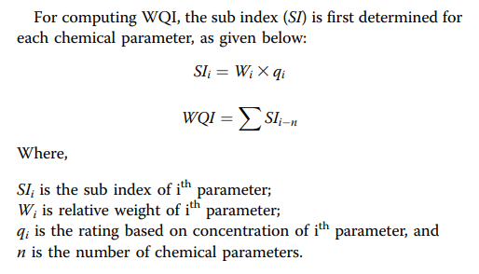

Slide 9
